Slide 1
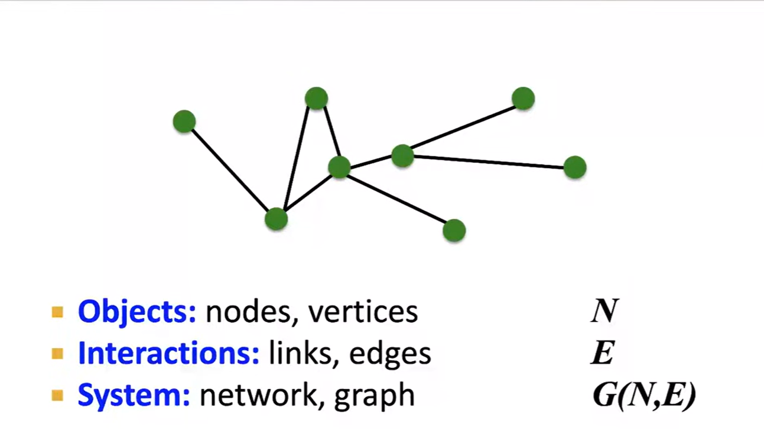
Components of a Network

Slide 2
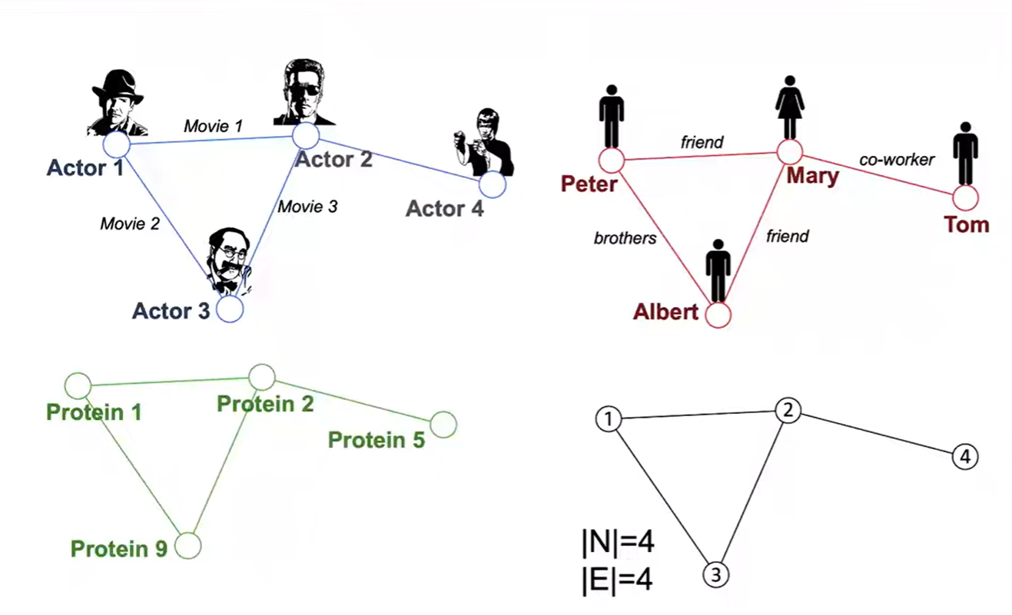
Graphs: A Common Language

Slide 3
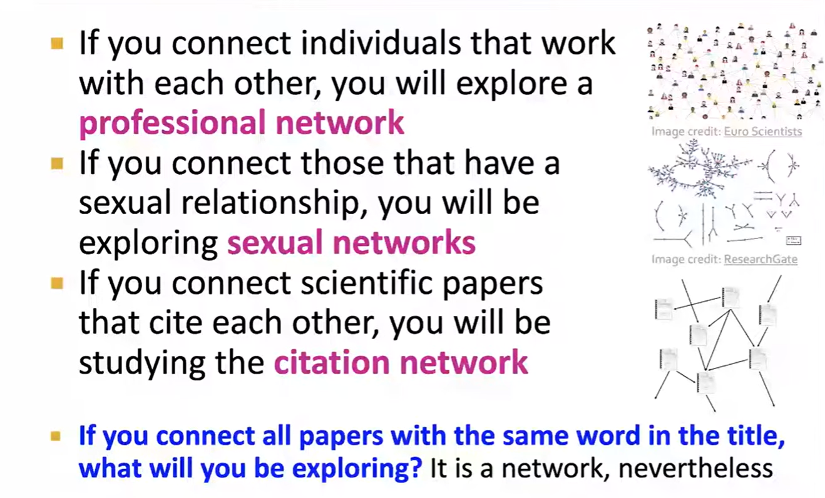
Choosing a Proper Representation

Slide 4
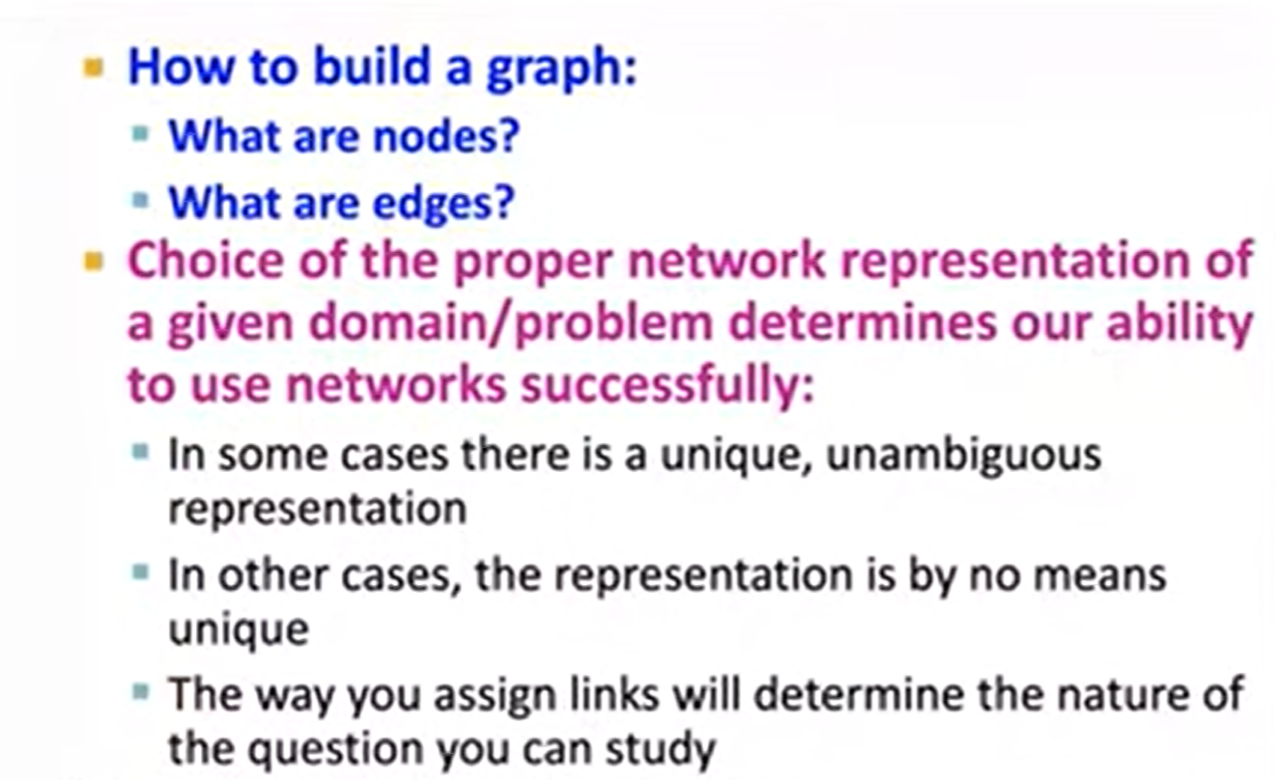
How do you degine a Graph

Slide 5
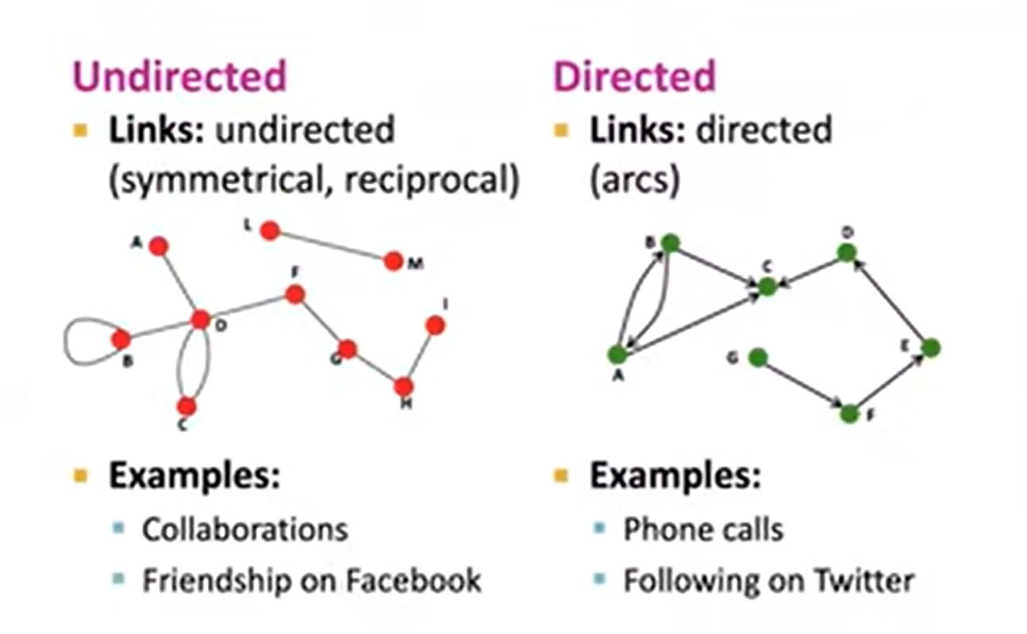
Directed VS Undirected Graphs

Slide 6

Node Degrees

Slide 7
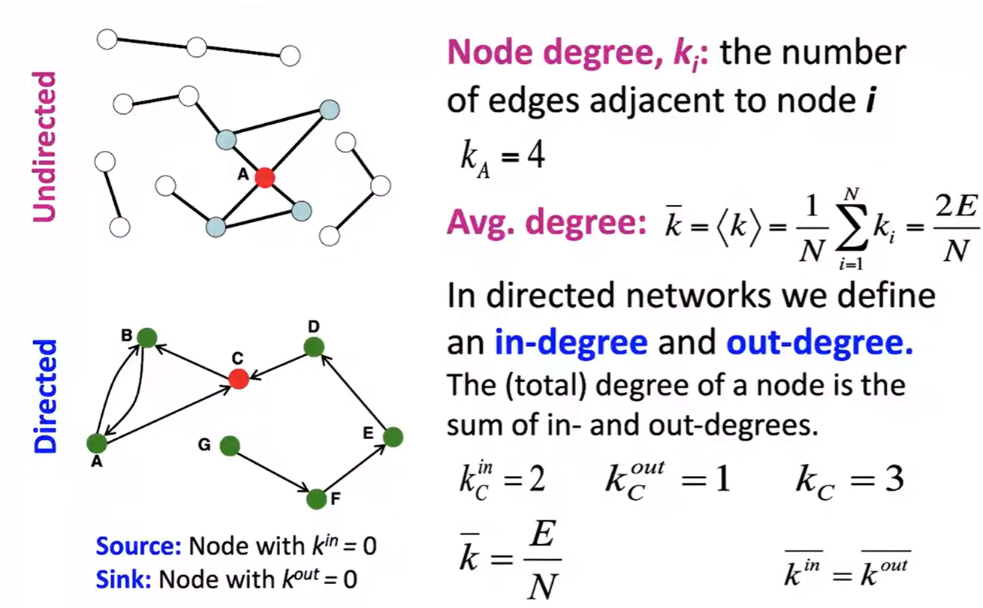
Node Degrees

Slide 8
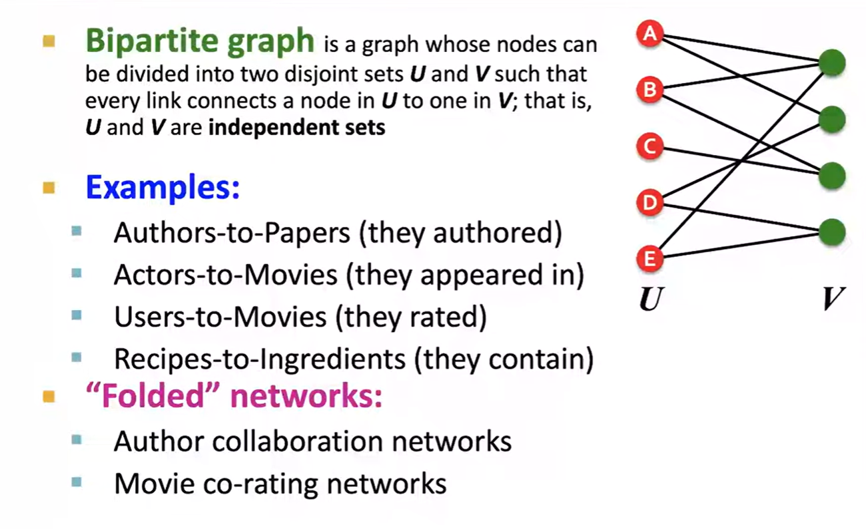
Bipartile Graphs

Slide 9
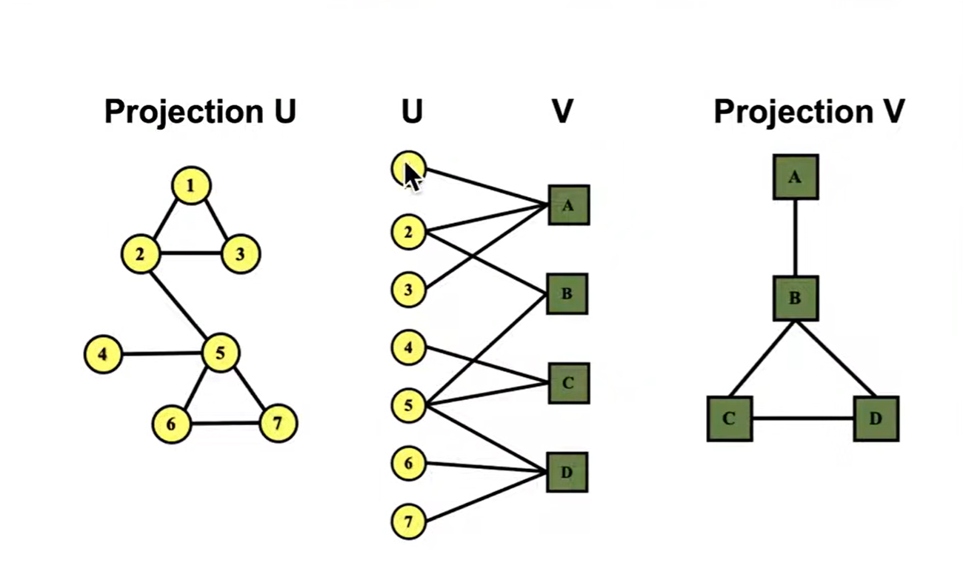
Folded / Projected Bipartile Graphs

Slide 10
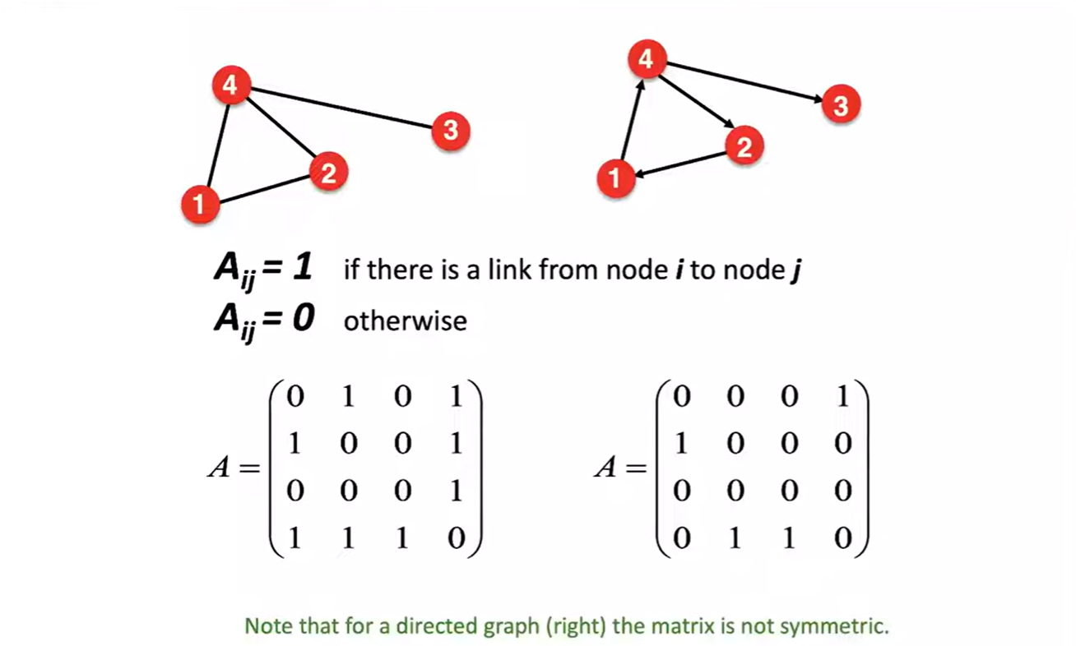
Representing Graphs: Adjacency Matrix

Slide 11
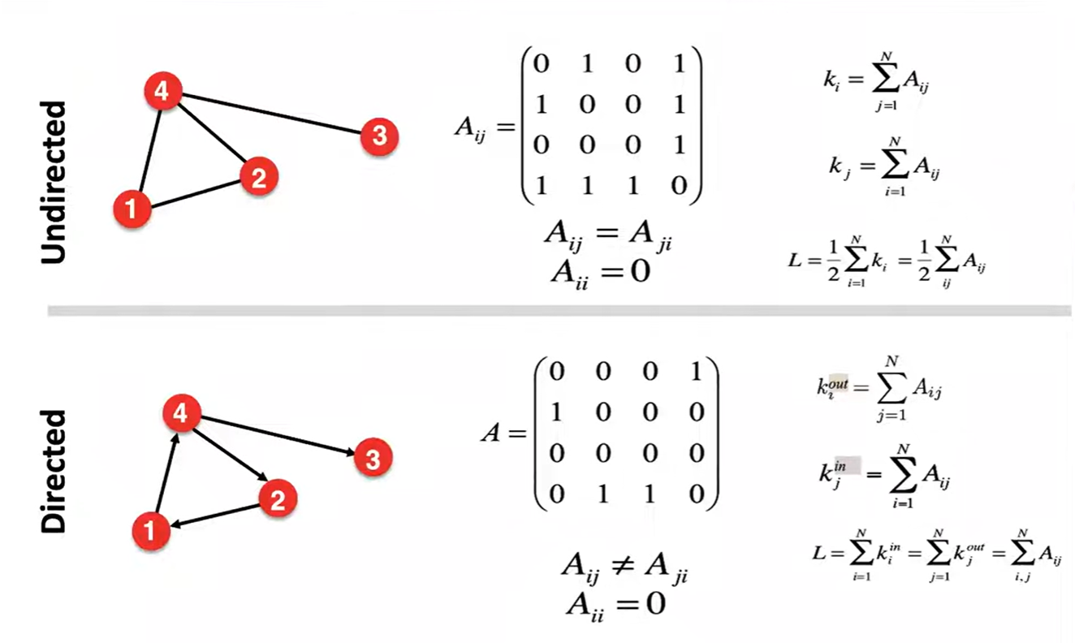
Adjacency Matrix

Slide 12
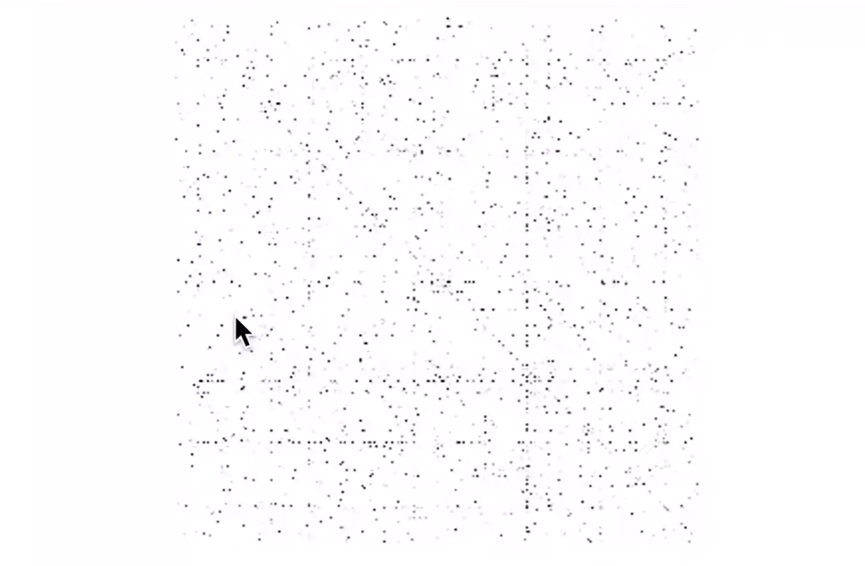
Adjacency Matrices are Sparse

Slide 13
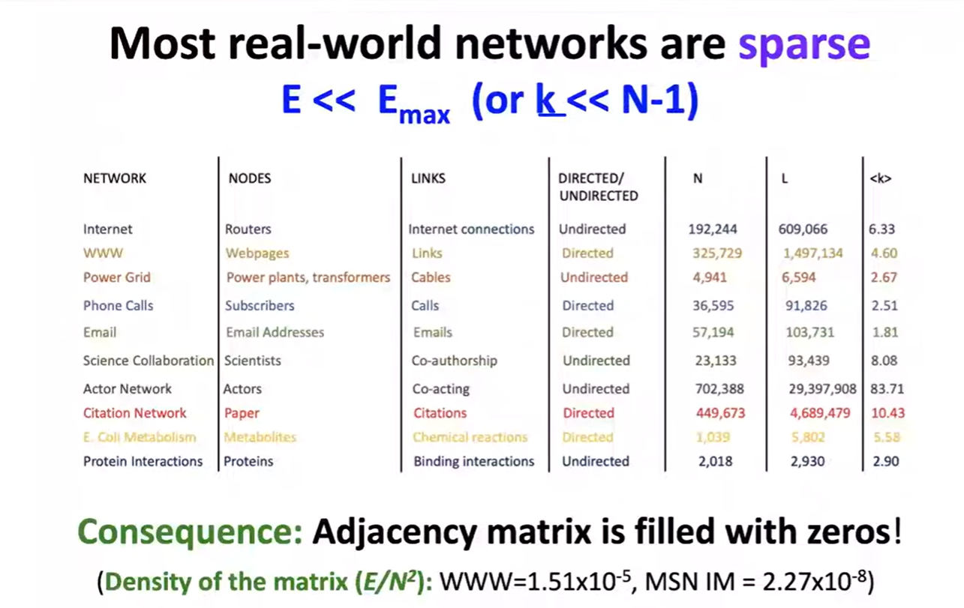
Networks are Sparse Graphs

Slide 14
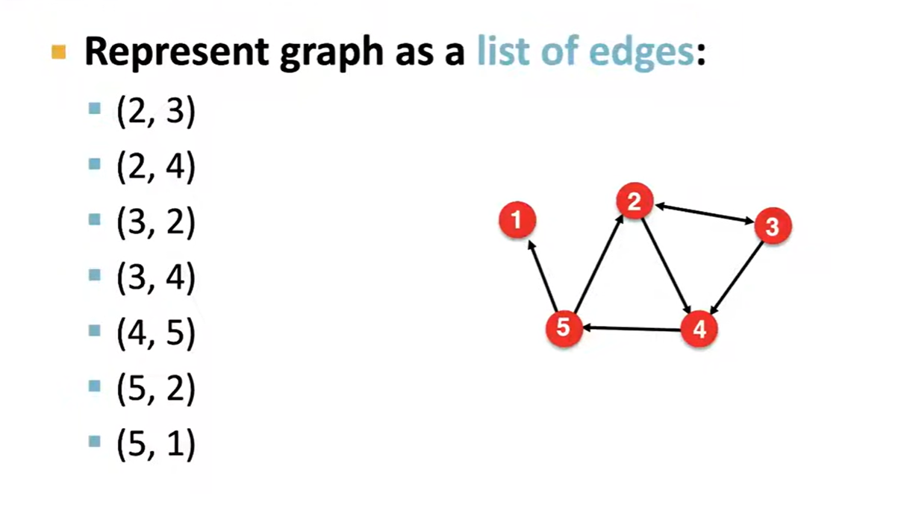
Representing Graphs: Edge List

Slide 15
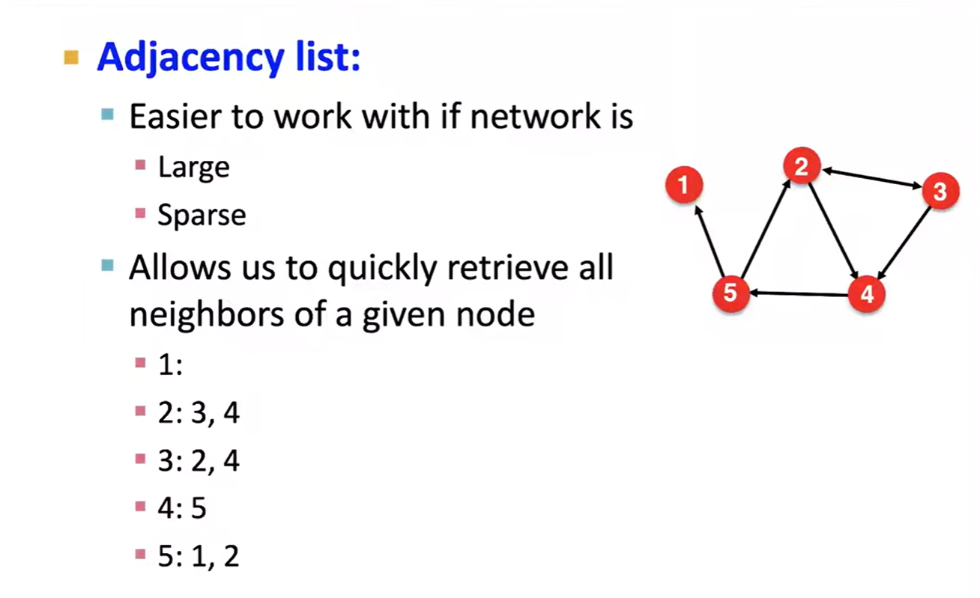
Representing Graphs: Adjacency List

Slide 16
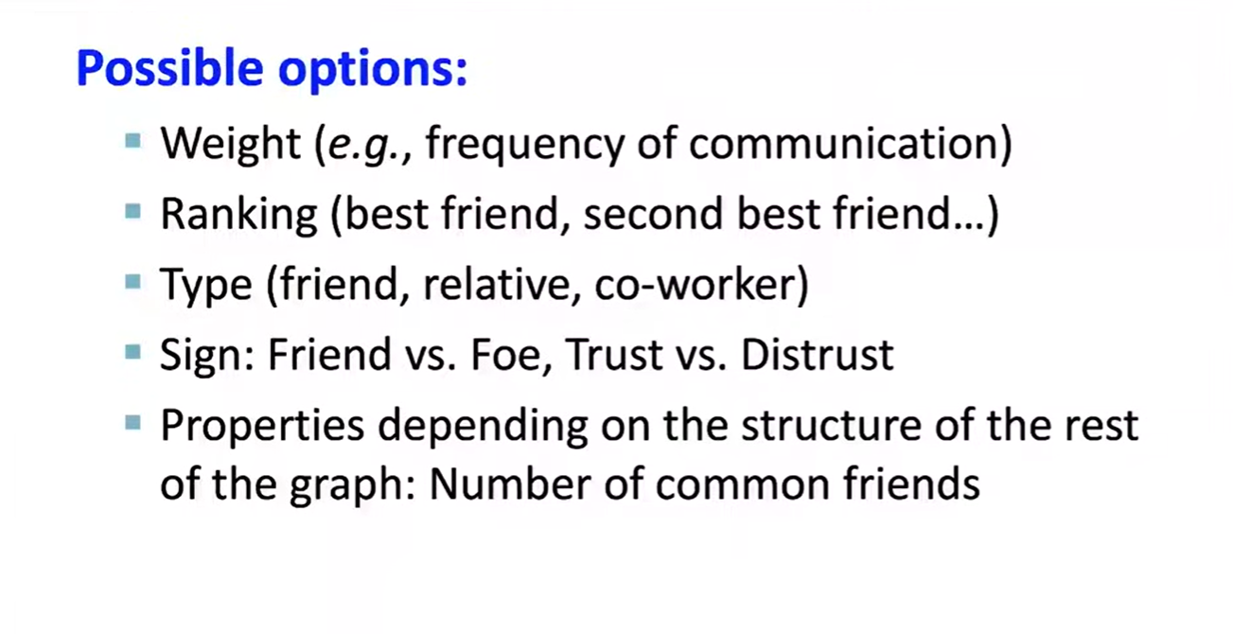
Node and Edge Attributes

Slide 17
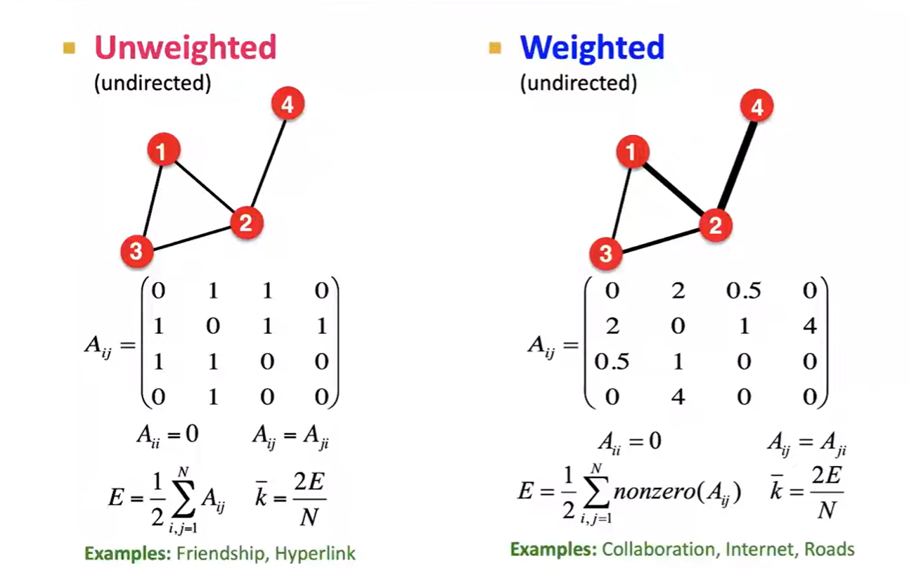
More Types of Graphs

Slide 18
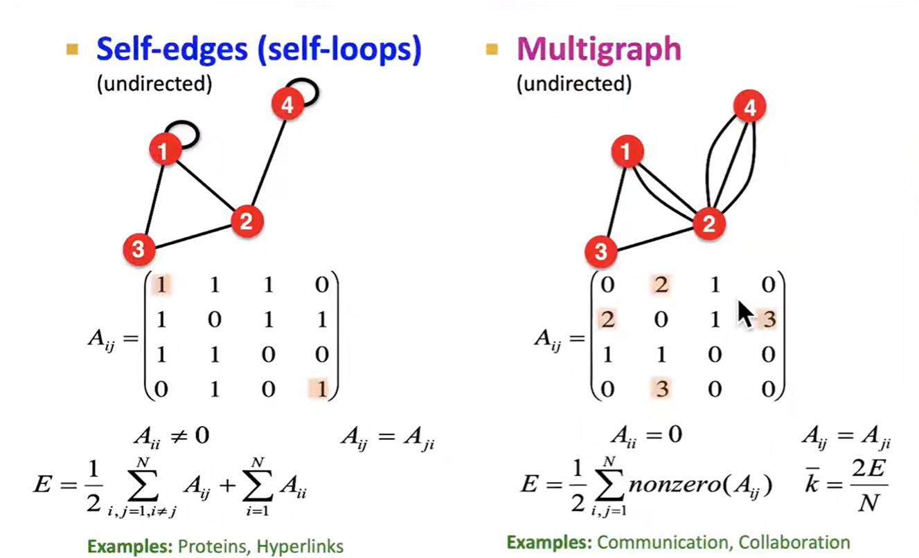
More Types of Graphs

Slide 19
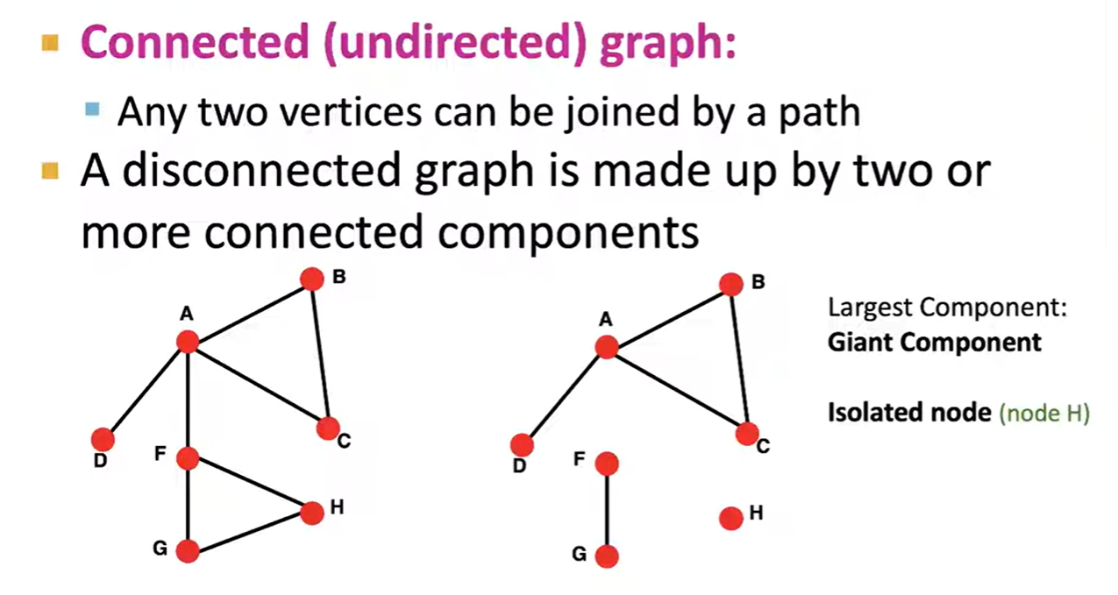
Connectivity of Undirected Graphs

Slide 20
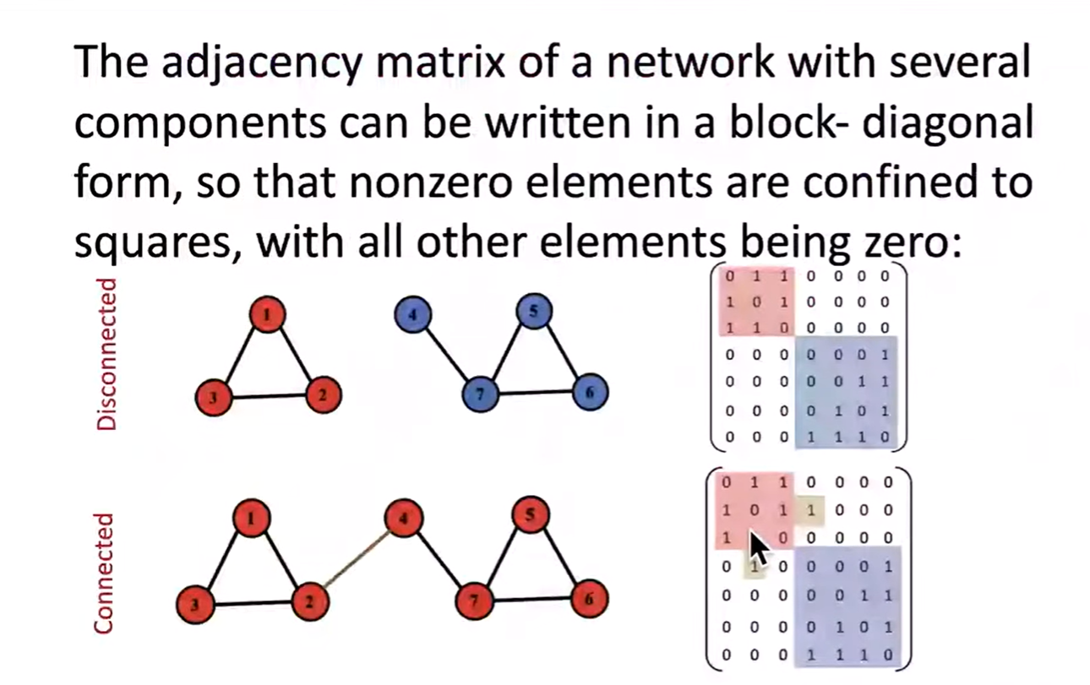
Connectivity: Example

Slide 21
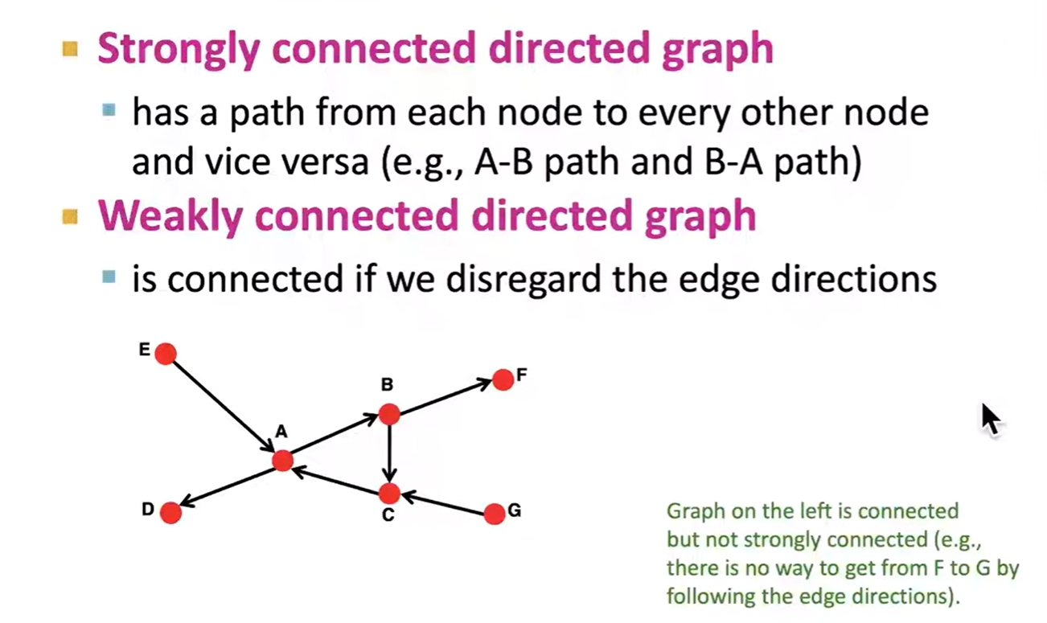
Connectivity of Directed Graphs

Slide 22
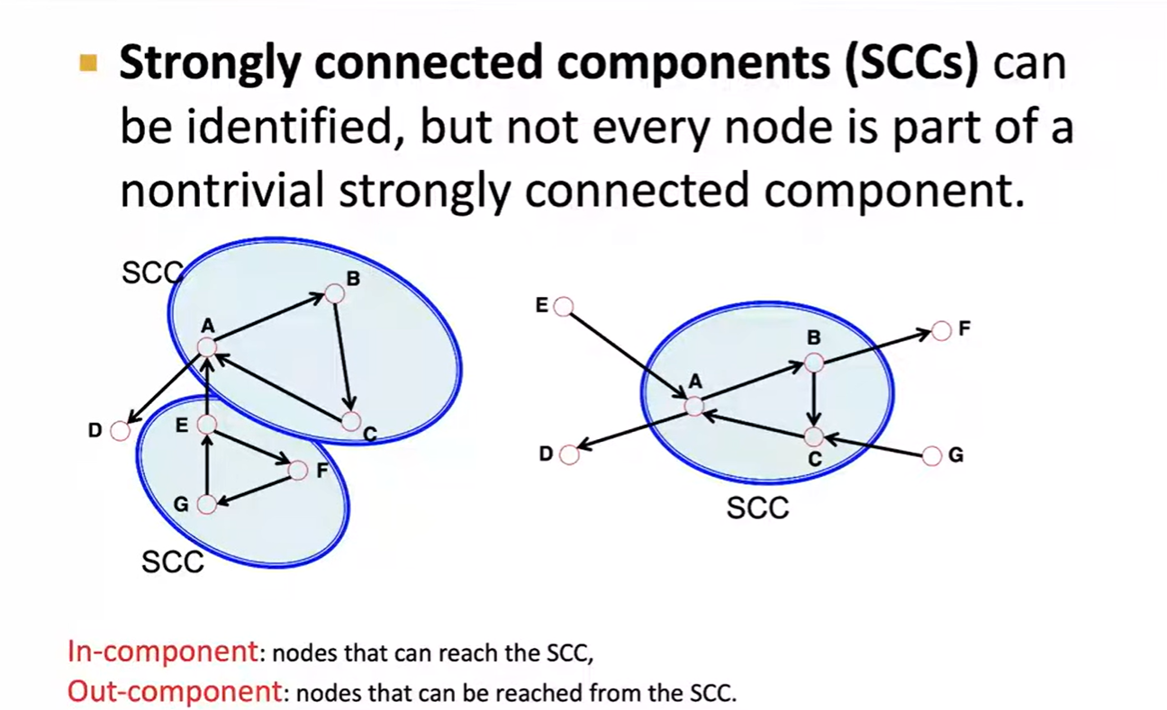
Connectivity of Directed Graphs

Slide 23
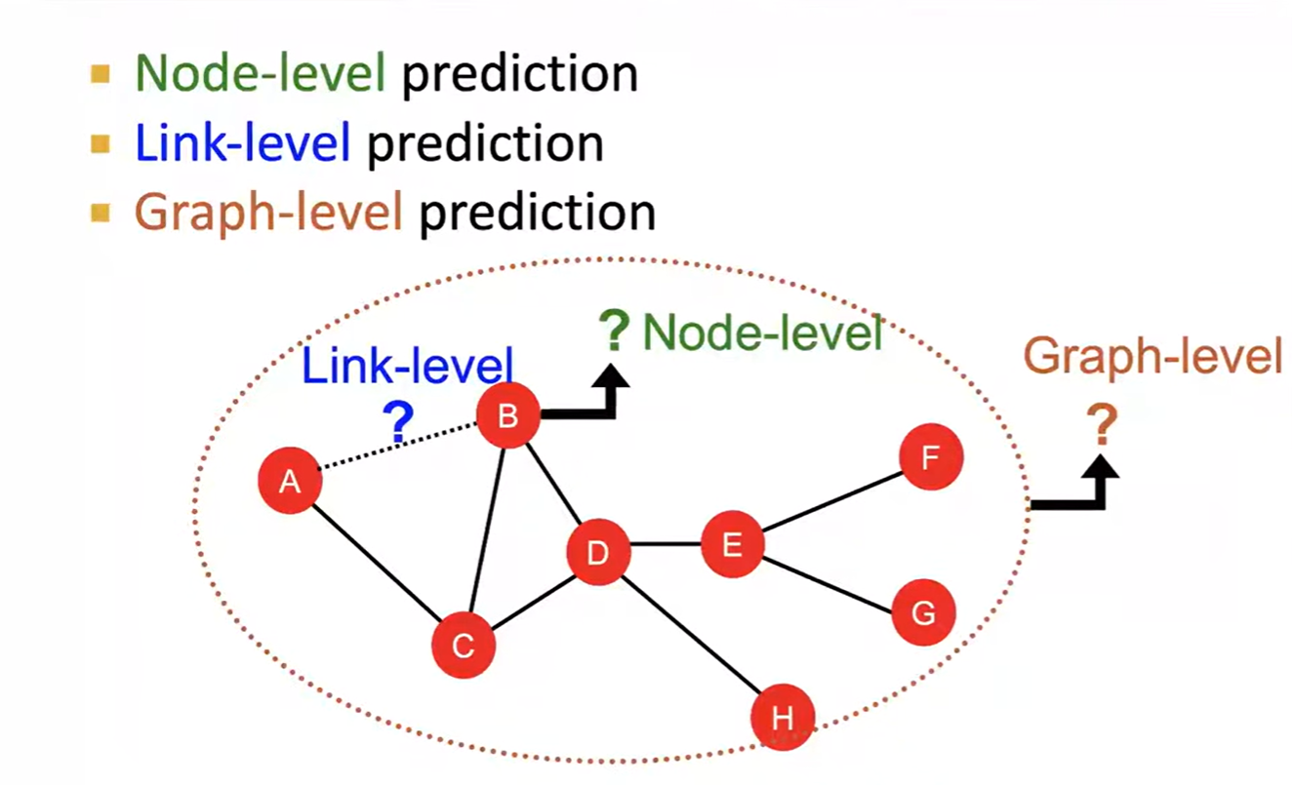
Machine Learning Tasks: Rewiew

Slide 24
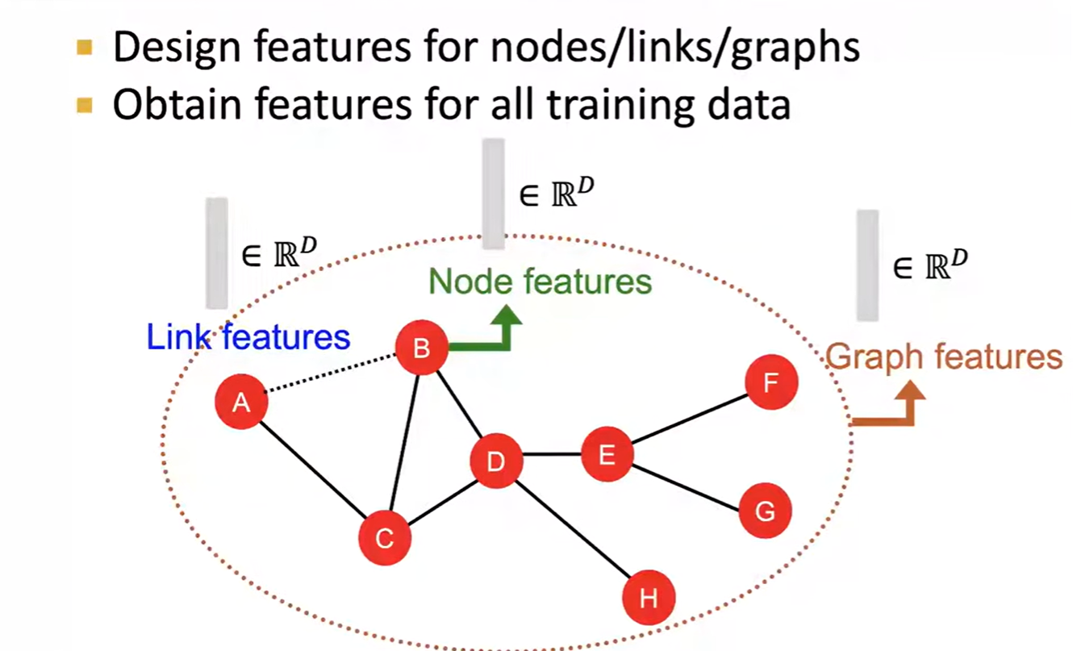
Traditional ML Pipeline

Slide 25
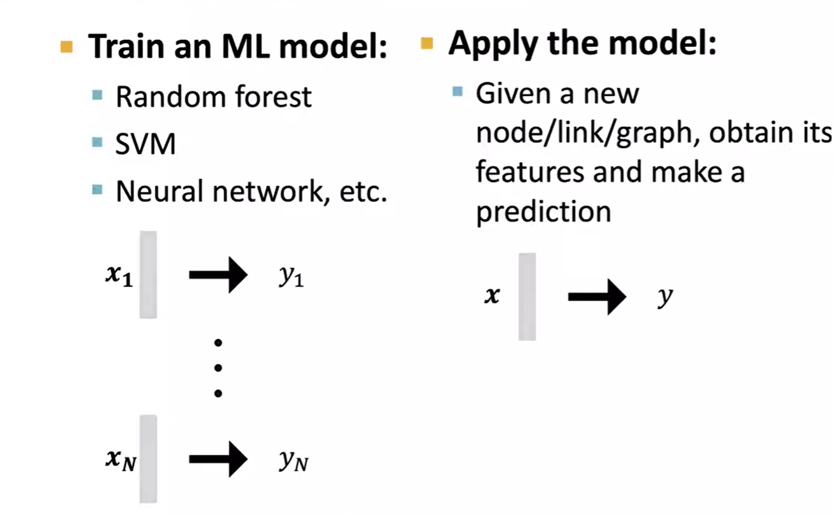
Traditional ML Pipeline

Slide 26
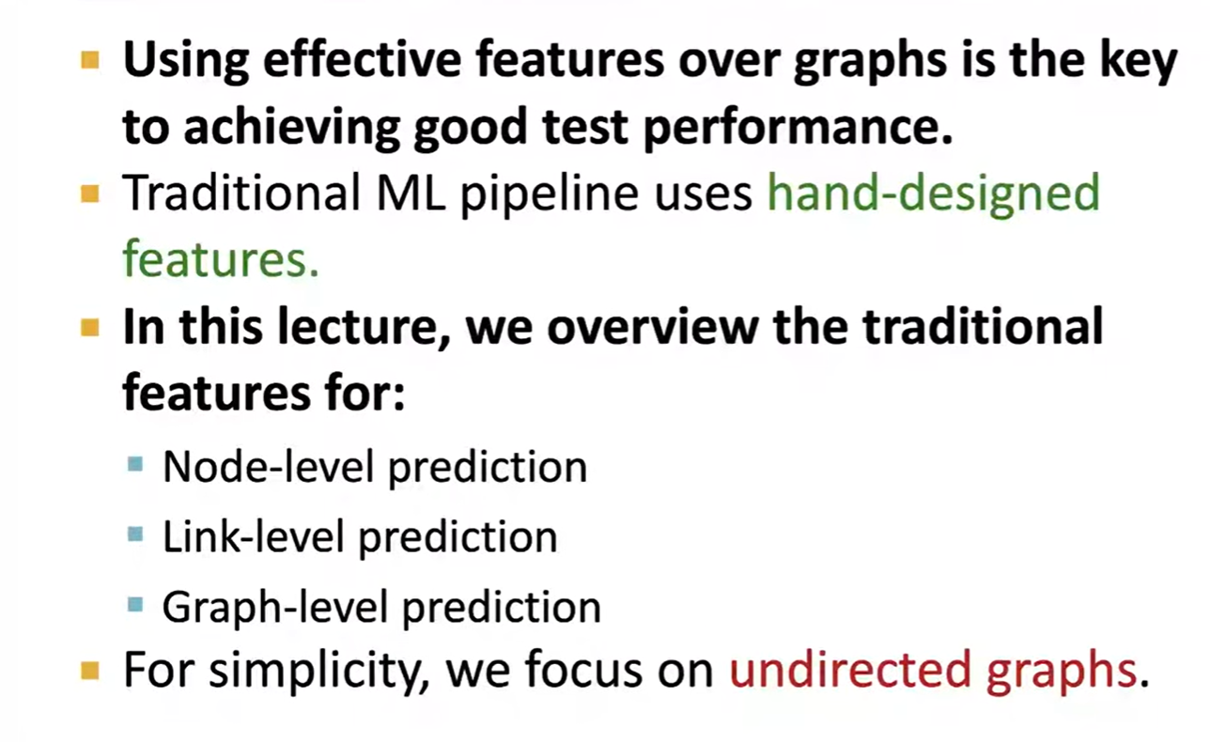
Feature Design (This Lecture)

Slide 27
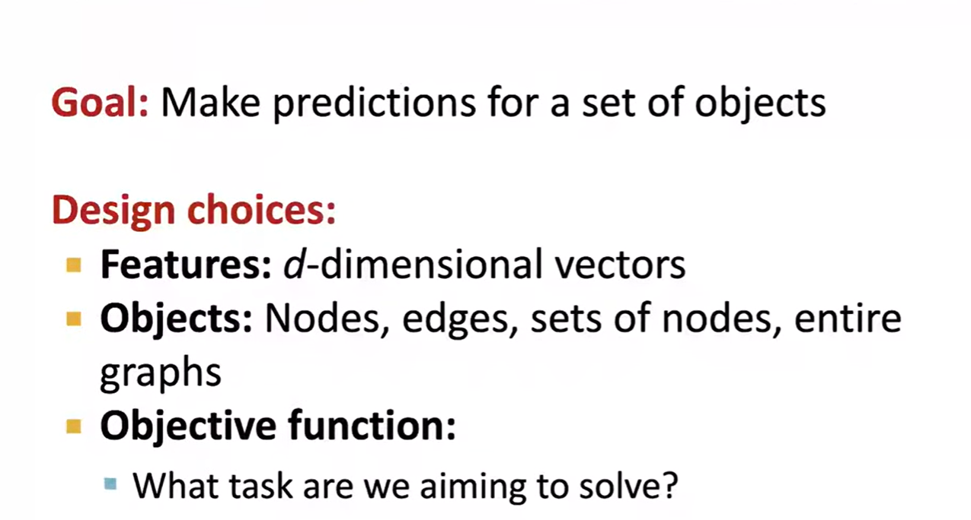
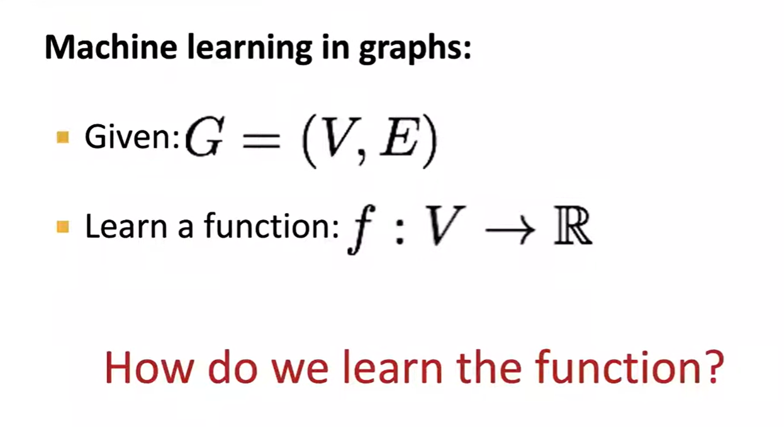
Machine Learning in Graphs

Slide 28
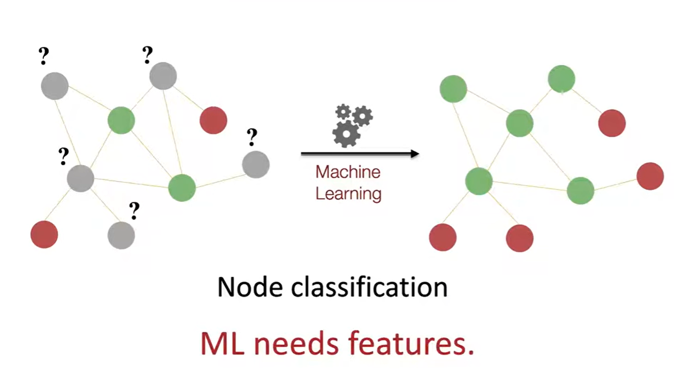
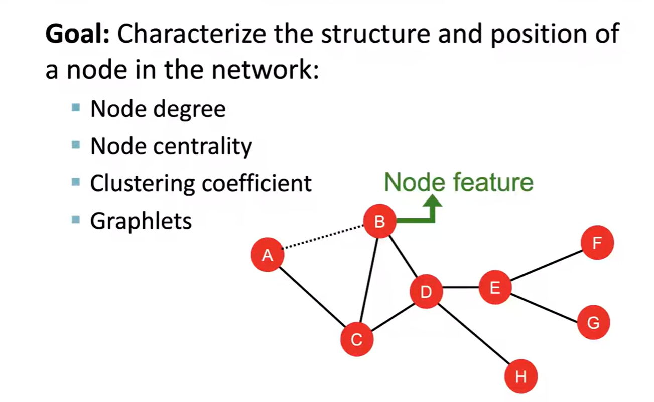
Node-Level Tasks

Slide 29
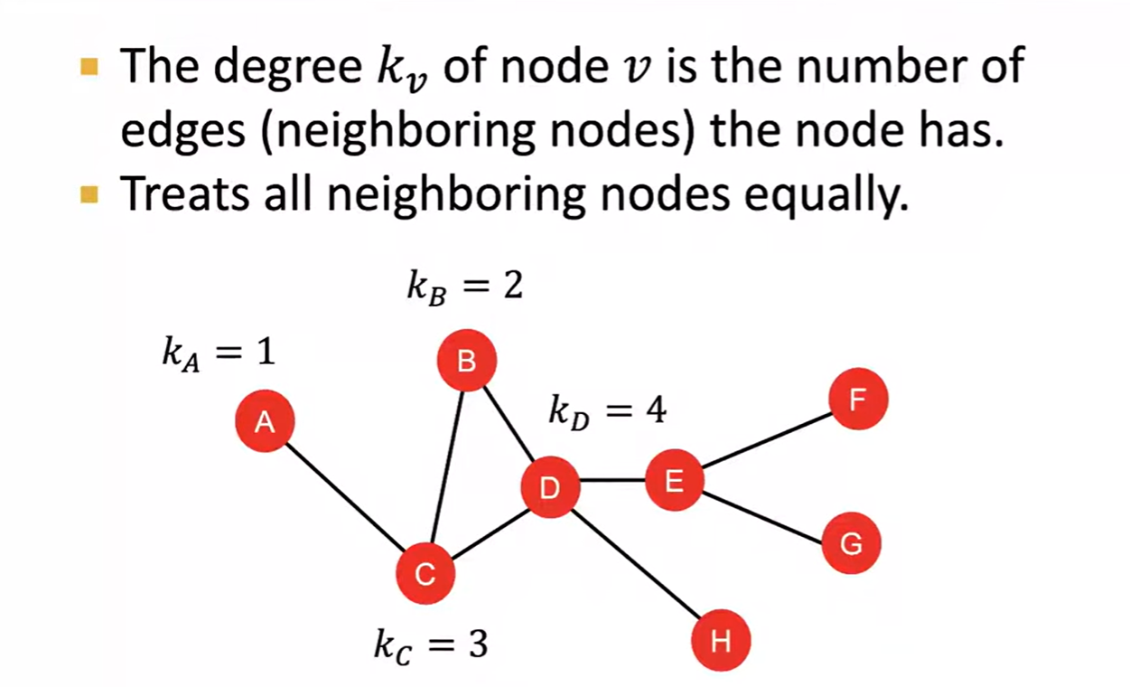
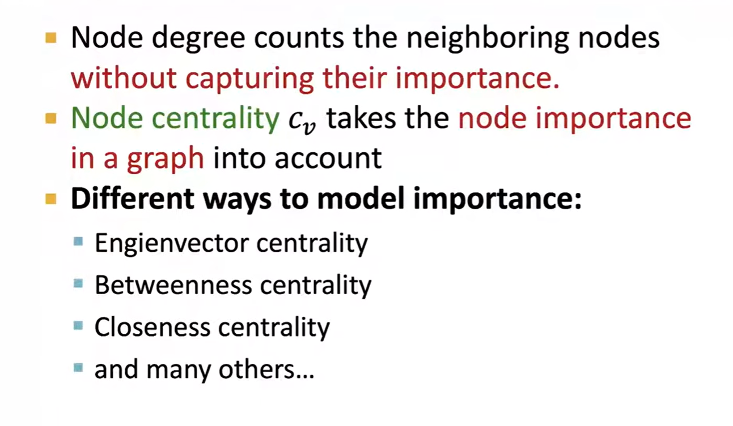
Node-Features Node Degree
Node-Features Node Centrality

Slide 30
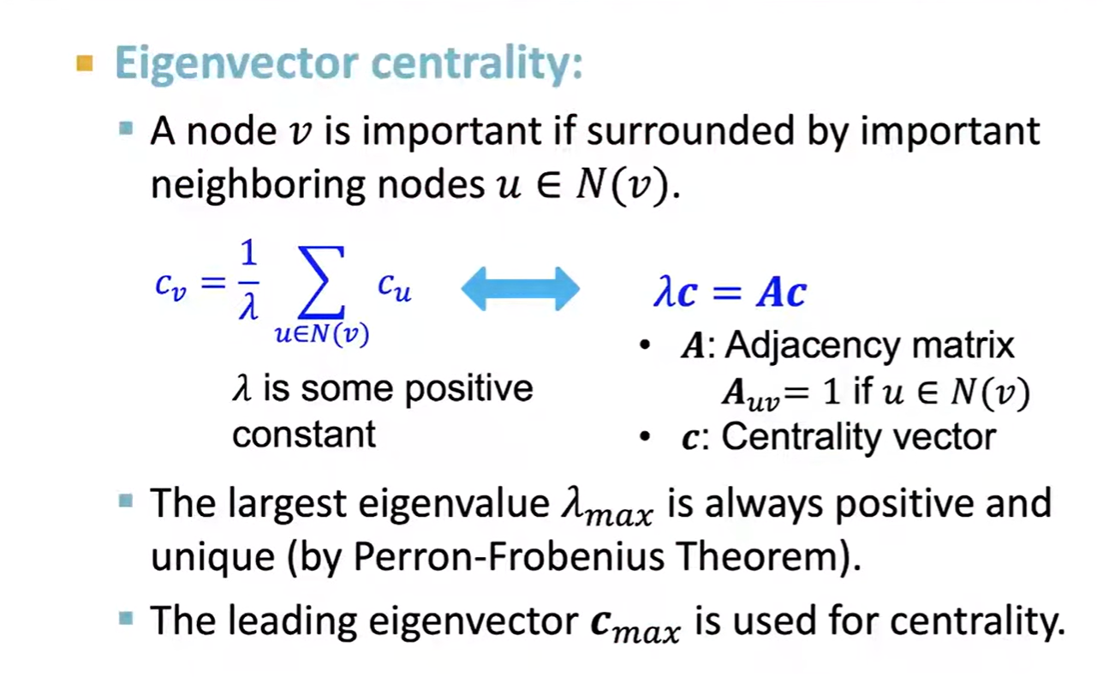
Node Centrality (1)
Perron–Frobenius theorem, asserts that a real square matrix with positive entries has a unique eigenvalue of largest magnitude and that eigenvalue is real

Slide 31
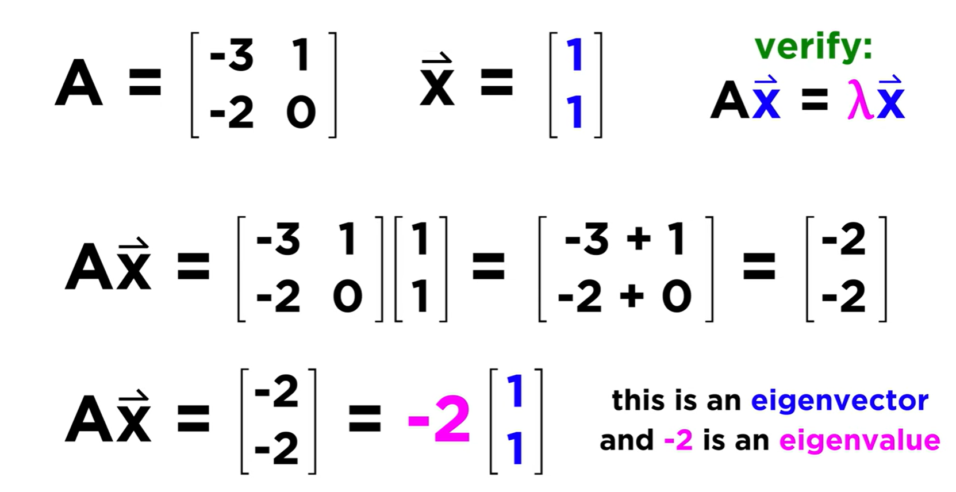

Eigen Values and Eigen Vectors

Slide 32
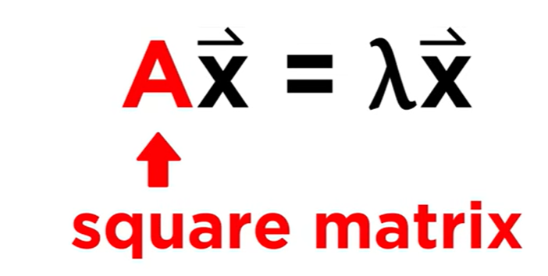
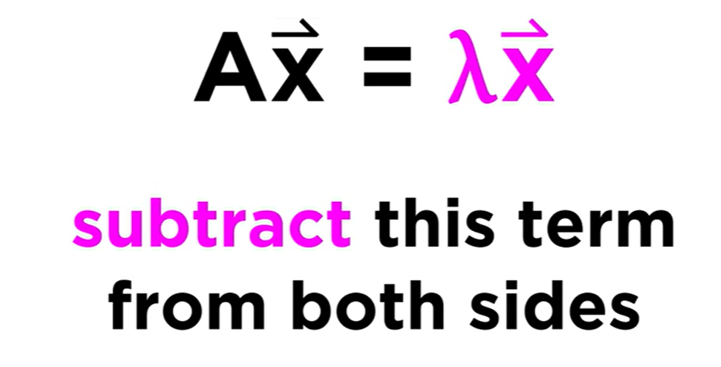

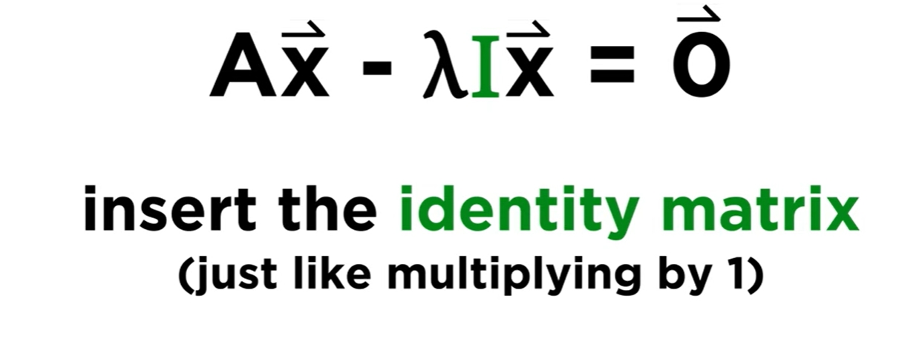



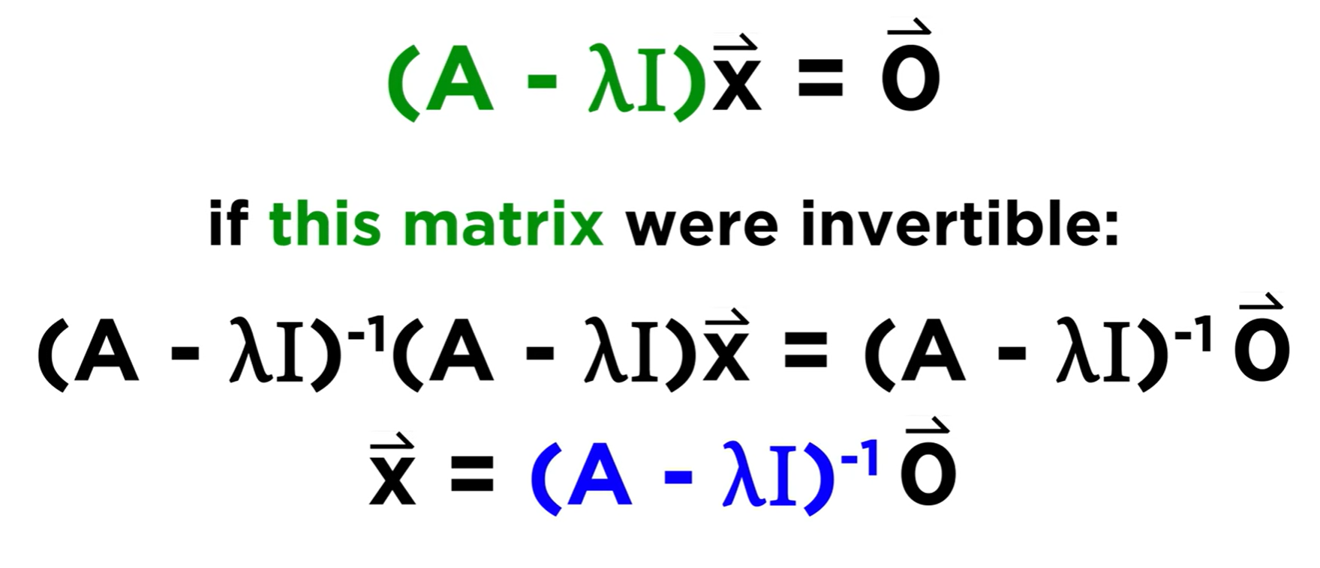

Slide 33
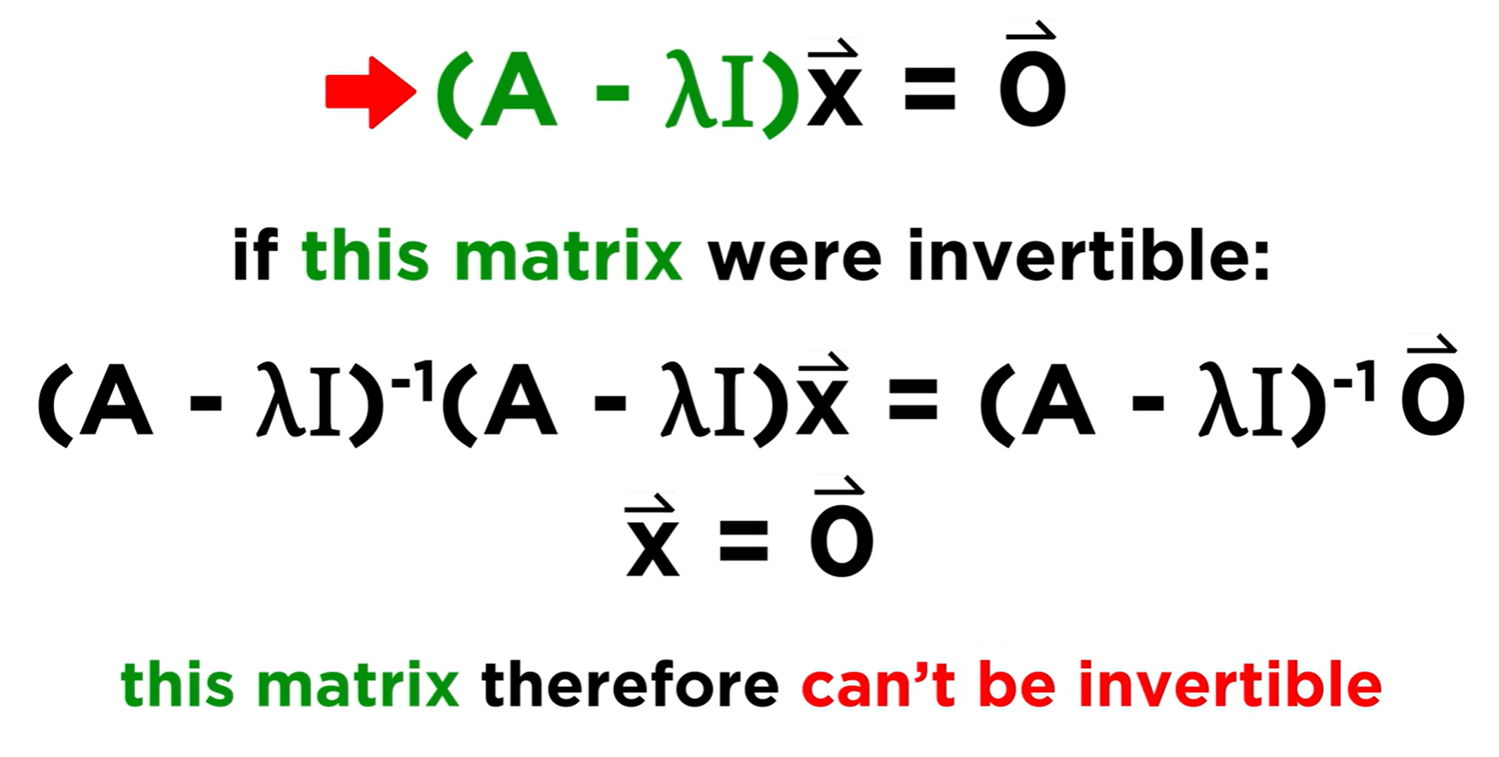
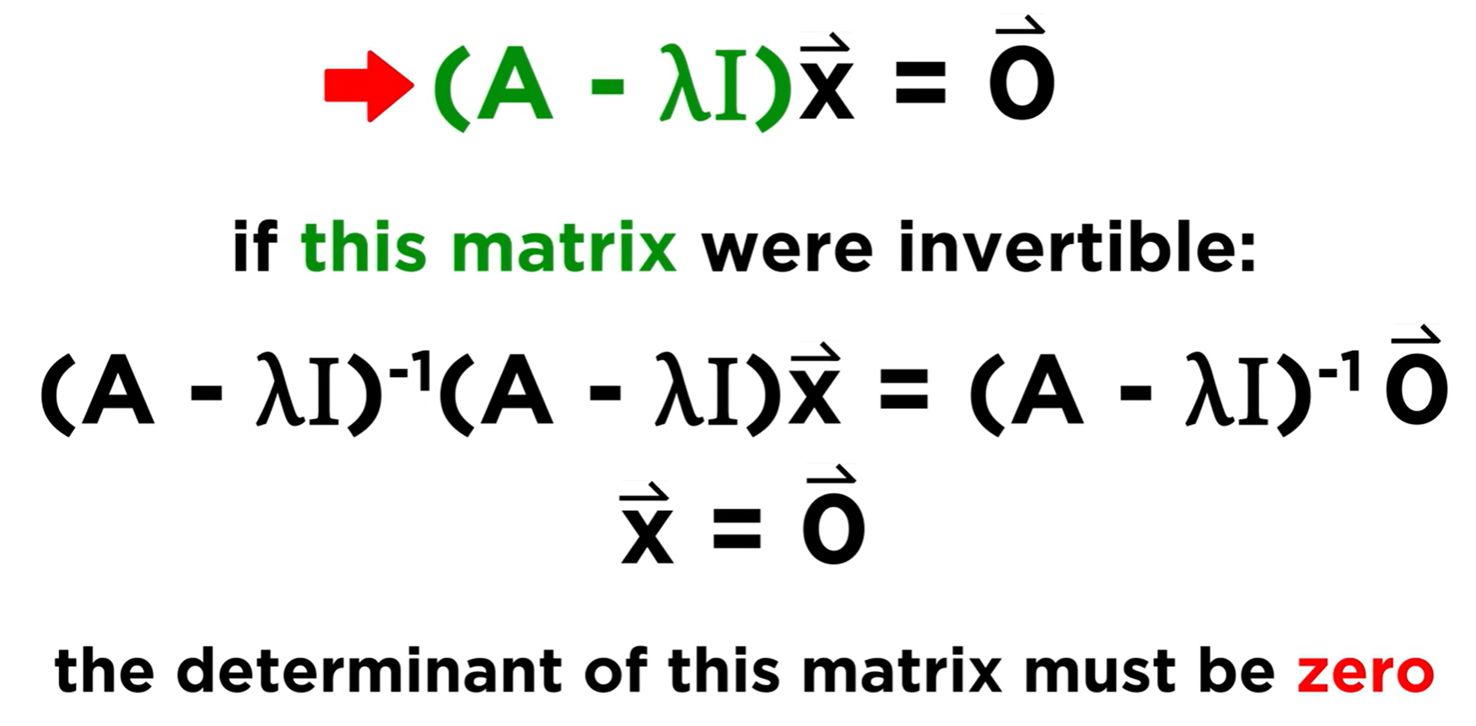

Slide 34
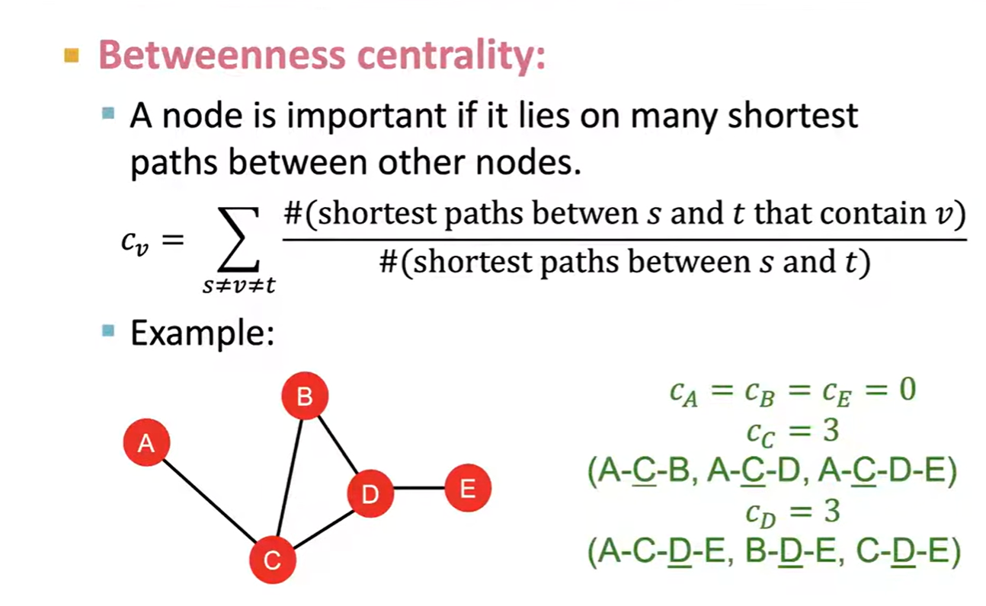
Node Centrality (2)

Slide 35
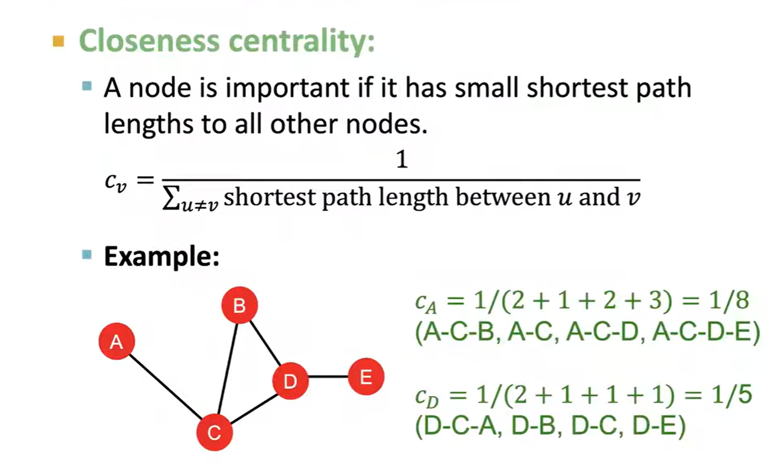
Node Closeness (3)

